Slide 1
TITLE: ORTHOGRAPHIC PROJECTION/VIEW
EGE PRACTICAL EXAM
NAME: ABDURRAHMAN QURESHI
ROLL NO: 210451

Slide 2
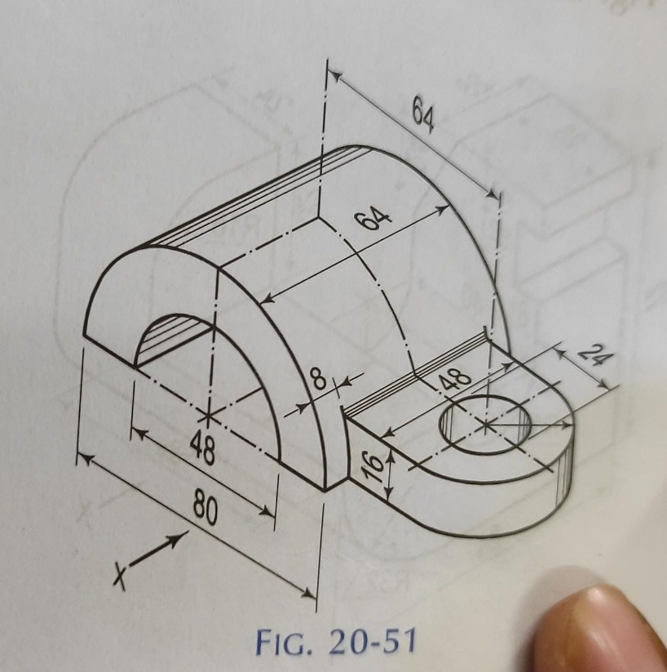
QUESTION: DRAW THE ORTHOGRAPHIC PROJECTION/VIEW FOR THE GIVEN DIAGRAM

Slide 3
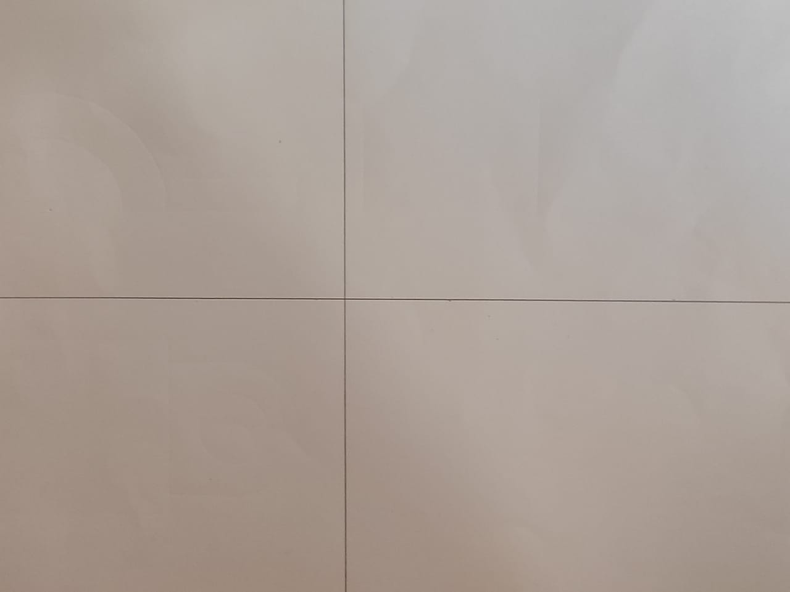
First step: divide the page into four quadrants

Slide 4
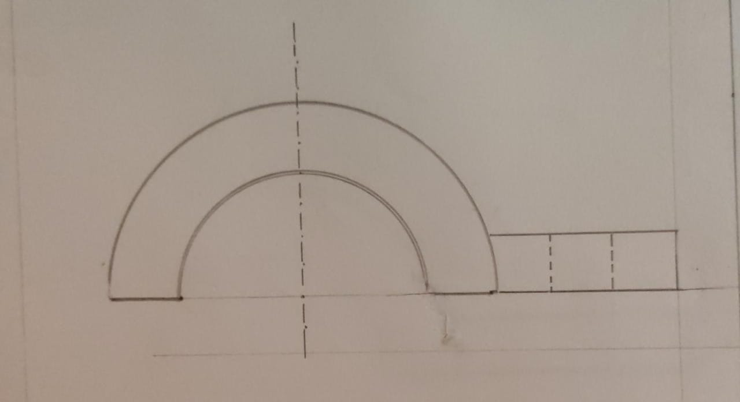
Second step: draw the front view carefully by observing the figure.

Slide 5
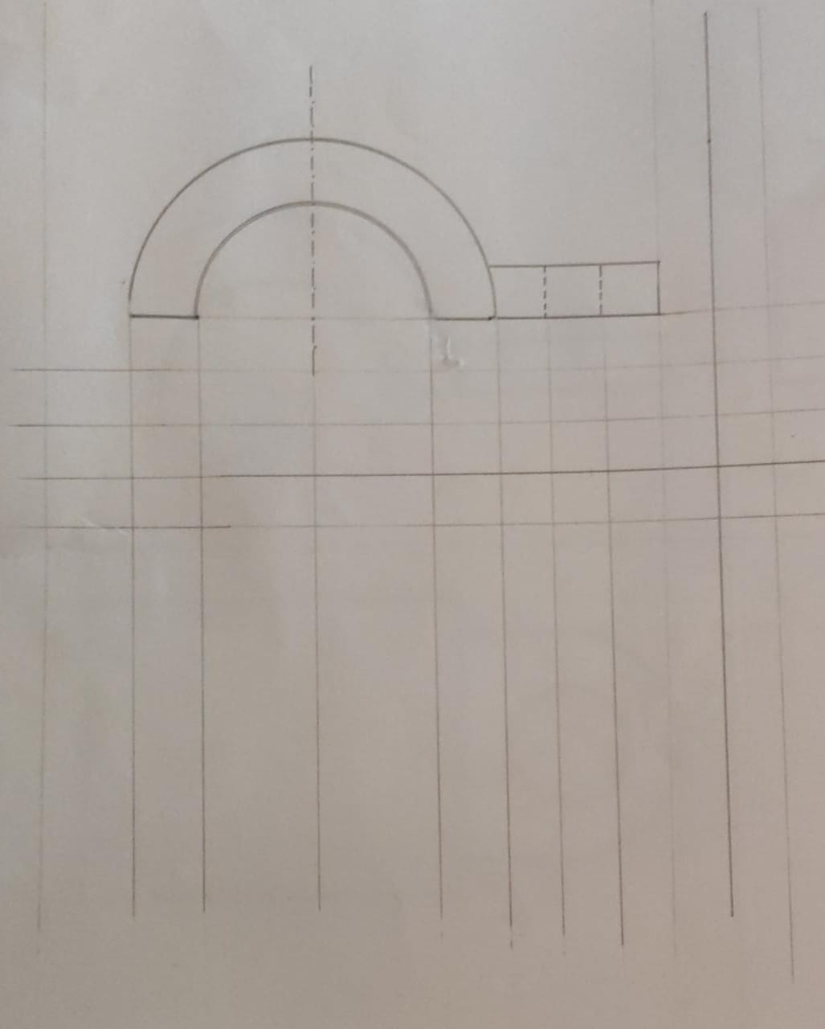
Third step: take the projections from the front view for the top view

Slide 6
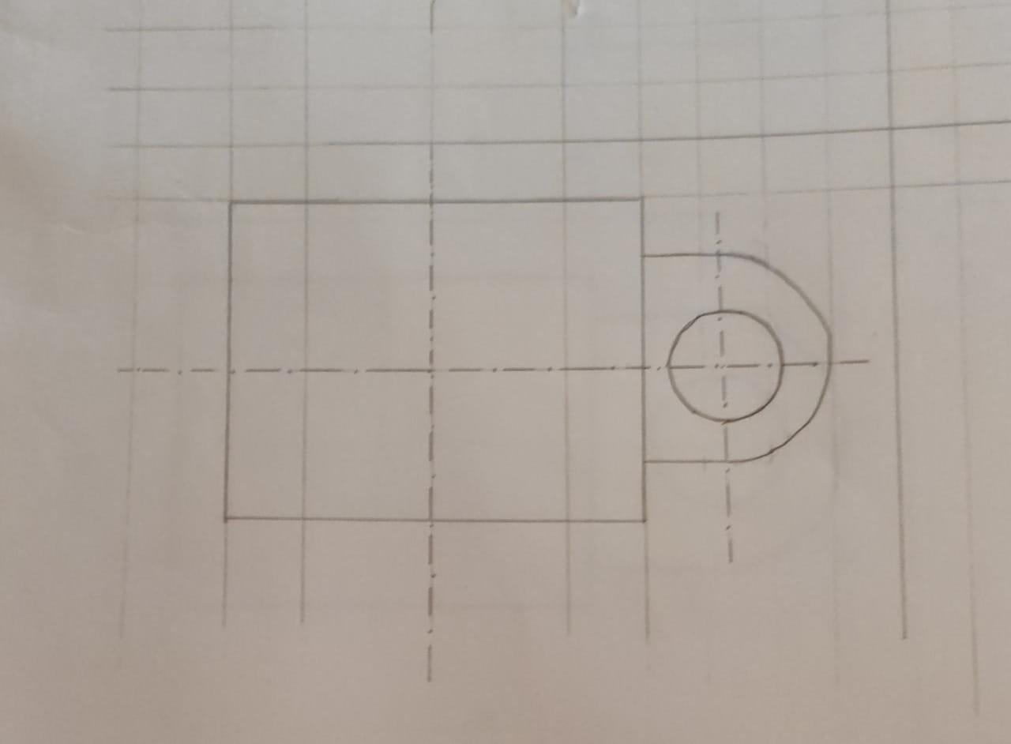
Step four: draw the top view carefully with help of the projections

Slide 7
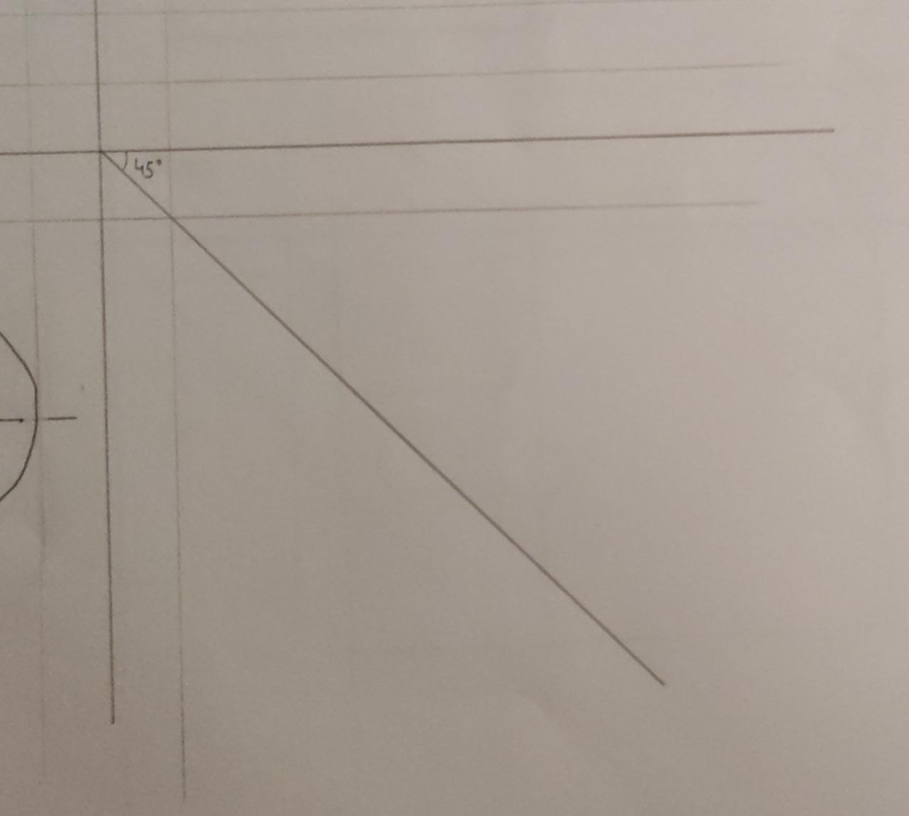
Fifth step: draw an angle of 45 degrees from the origin in 4th quadrant

Slide 8
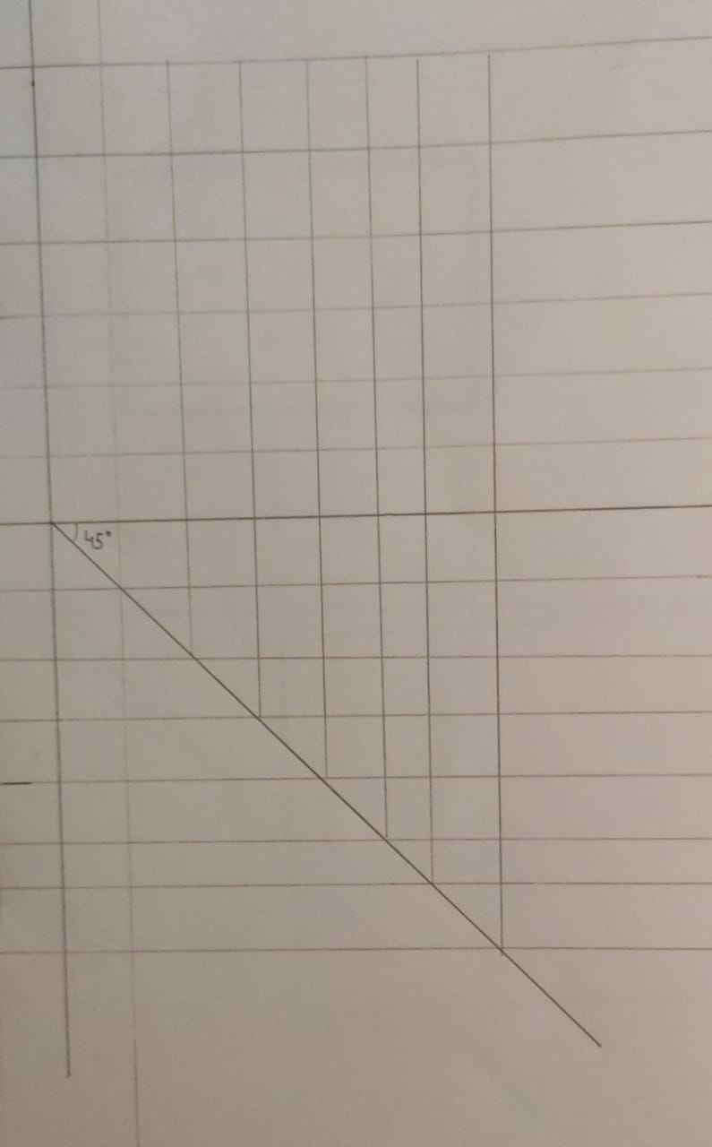
Sixth step: take projections from the top view and the front view for the side view

Slide 9
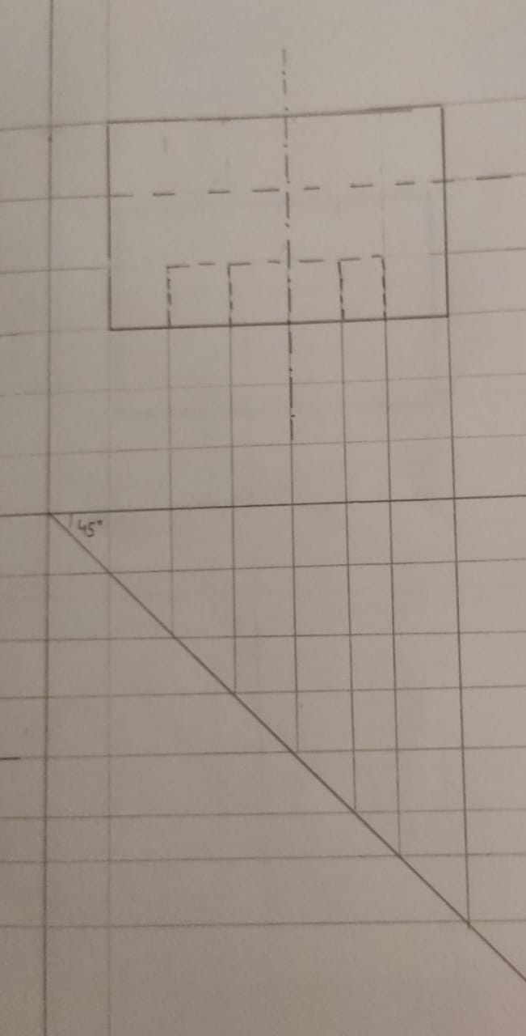
Seventh step: carefully draw the side view with the help of the projections

Slide 10
Eight step: check for hidden line, give the measurements to front view , top view , and the side view. Also check the curves and lines again.

Slide 11
The final answer contains the front view , top view and the side view with the given accurate measurements along with the hidden lines.

Slide 12
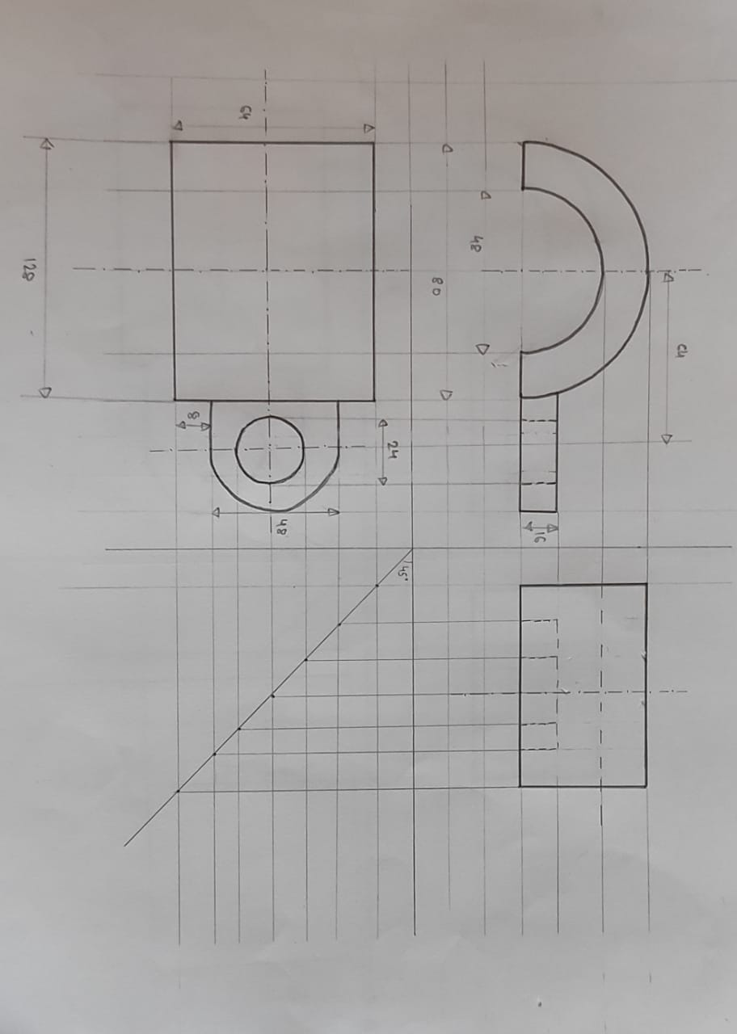
Final answer:

